Slide 1

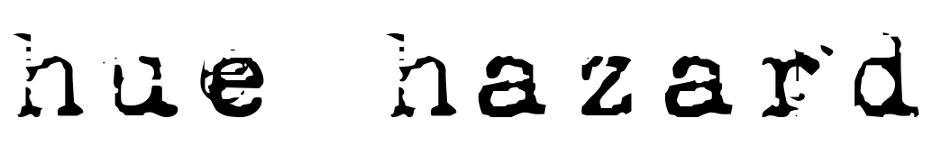
Audio-Visual Test

Slide 2



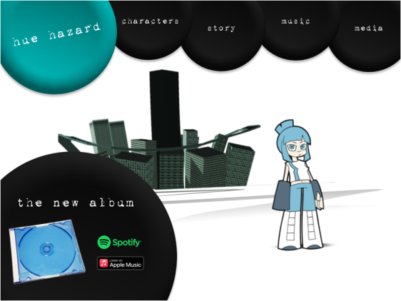
Audio Snippet 1
Please listen to the audio snippet.
Which aesthetic best fits the music?
A
B
C

Slide 3
Audio Snippet 2
Please listen to the audio snippet.
Which aesthetic best fits the music?
A
B
C

Slide 4
Audio Snippet 3
Please listen to the audio snippet.
Which aesthetic best fits the music?
A
B
C

Slide 5
Audio Snippet 4
Please listen to the audio snippet.
Which aesthetic best fits the music?
A
B
C

Slide 6
Final Question
Which aesthetic generally fits the music you’ve heard best?
A
B
C

Slide 7
Thank You!

